Slide 1
Collision Detection and TTC calculation
Craig Beal
Bucknell University
2.22.2022

Slide 2
Vehicle Trajectory Geometry
CG (circle) and CG path (black dash-dot line)
Front left and front right corner paths (gray lines)
Maximum clearance radius (blue line)
Minimum clearance radius (red line)

Slide 3
Need to consider all possible collision/near miss possibilities
 | Front of Car | Inside of Car | Outside of Car
Vertex within track width | Direct calculation of vertex angle relative to center | N/A | N/A
Vertex between inside front corner and min radius | N/A | Calculate distance ahead of CG for collision then offset from vertex angle | N/A
Vertex between outside front corner and max radius | N/A | N/A | Calculate distance behind CG for collision then offset from vertex angle
Edge entirely within track width | Handled by vertex checks | N/A | N/A
Edge between min radius and track width | Handled by vertex check if track width vertex comes first | Circle/edge intersection check with inside front | N/A
Edge between max radius and track width | Handled by vertex check if track width vertex comes first | N/A | Circle/edge intersection check with outside front
Edge spans the track width but vertices within min and max radii | N/A unless edge is perfectly parallel to front of car | Circle/edge intersection check with inside front | Circle/edge intersection check with outside front
Edge spans min and max radii | N/A unless edge is perfectly parallel to front of car | Circle/edge intersection check with inside front | Circle/edge intersection check with outside front
Edge spans max radius with vertex outside of outer front track radius | N/A | N/A | Circle/edge intersection check with outside rear OR vertex check behind CG (depends on edge angle)
Edge spans min radius with vertex outside of inner front track radius | N/A | Vertex check ahead of CG | N/A
Vertices outside max/min radii (near miss) | N/A | Determine point with minimum difference from CG radius by vertices | Determine point with minimum difference from CG radius by vertices and nearest point on edges.

Slide 4
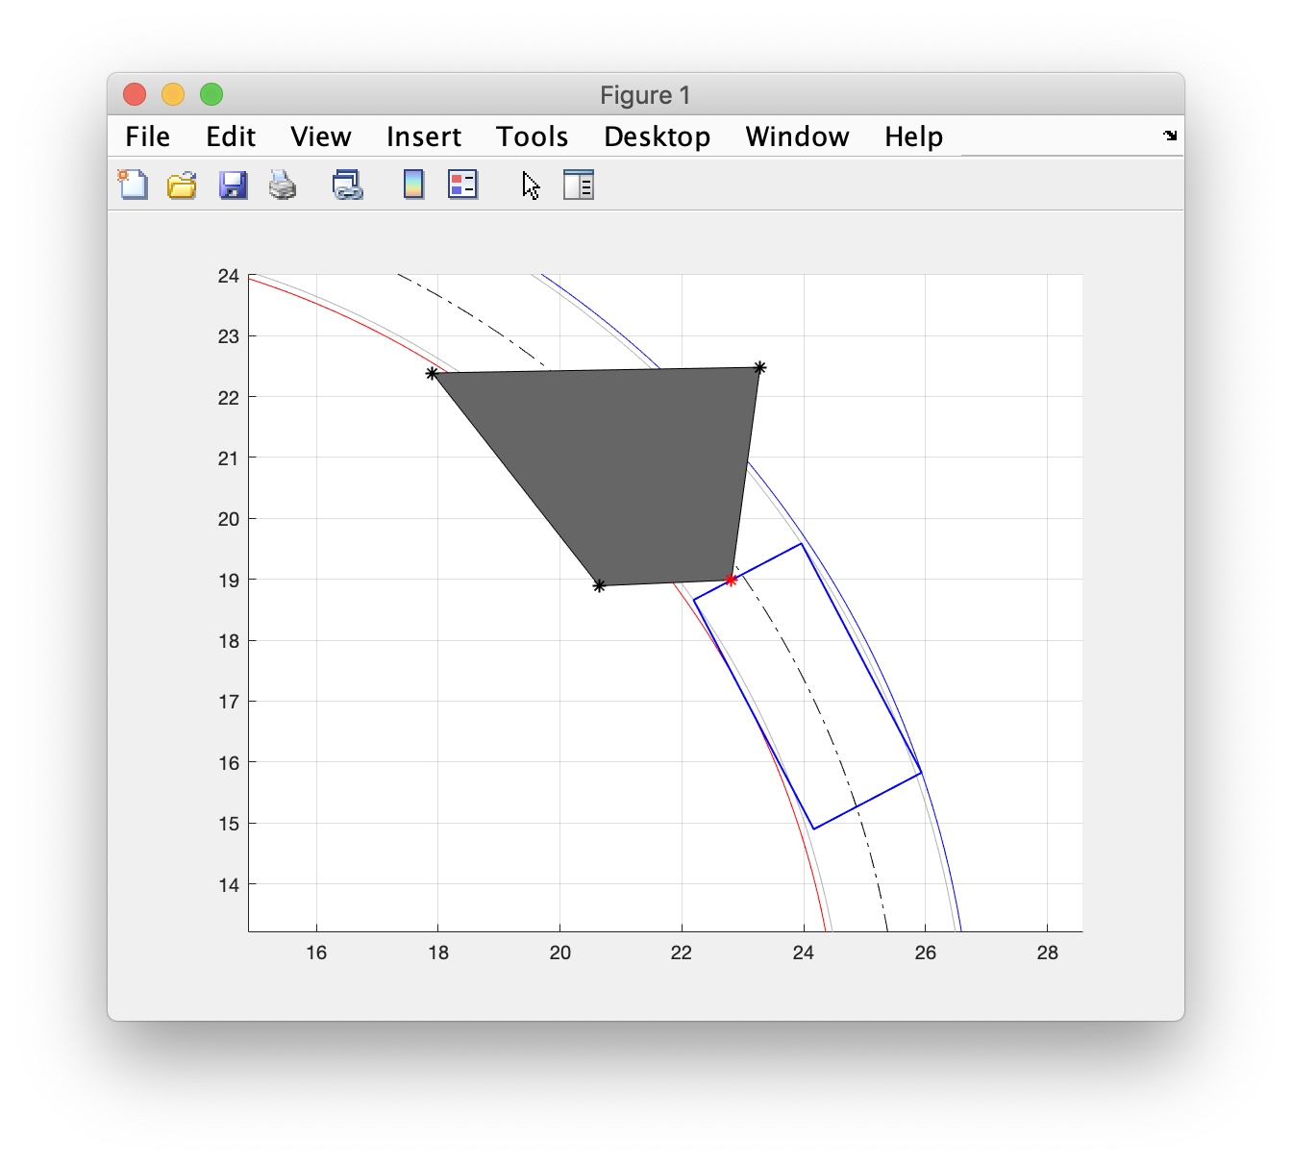
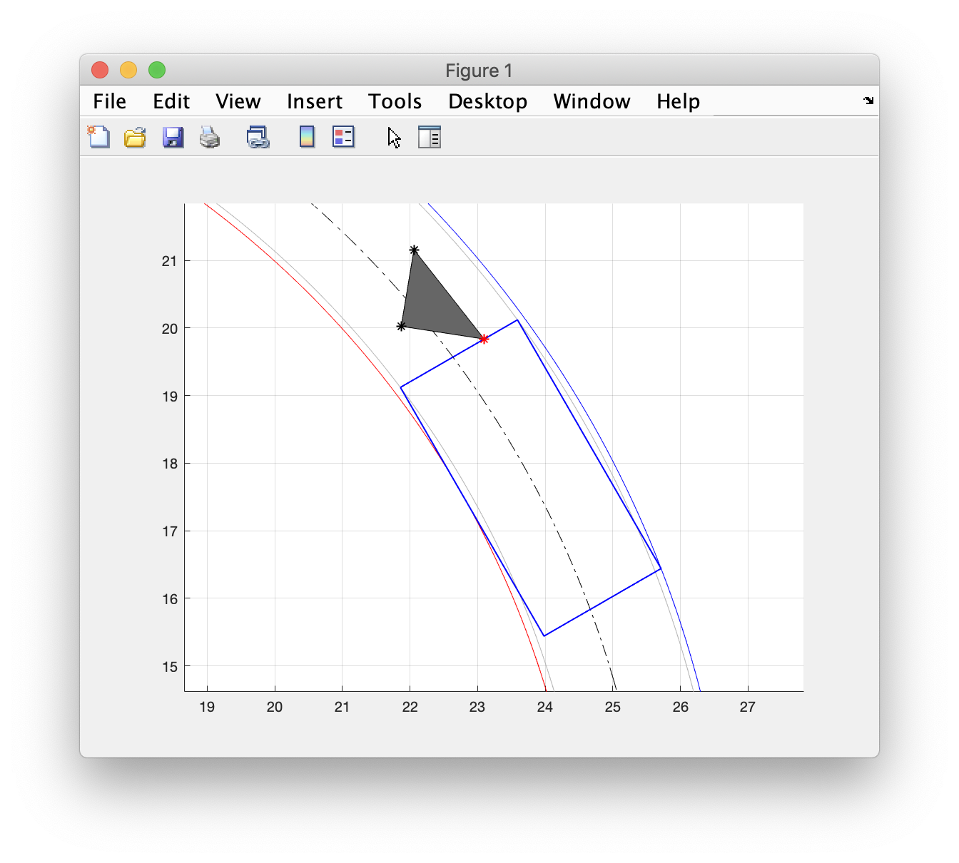
Vertex/vertices within track width

Slide 5
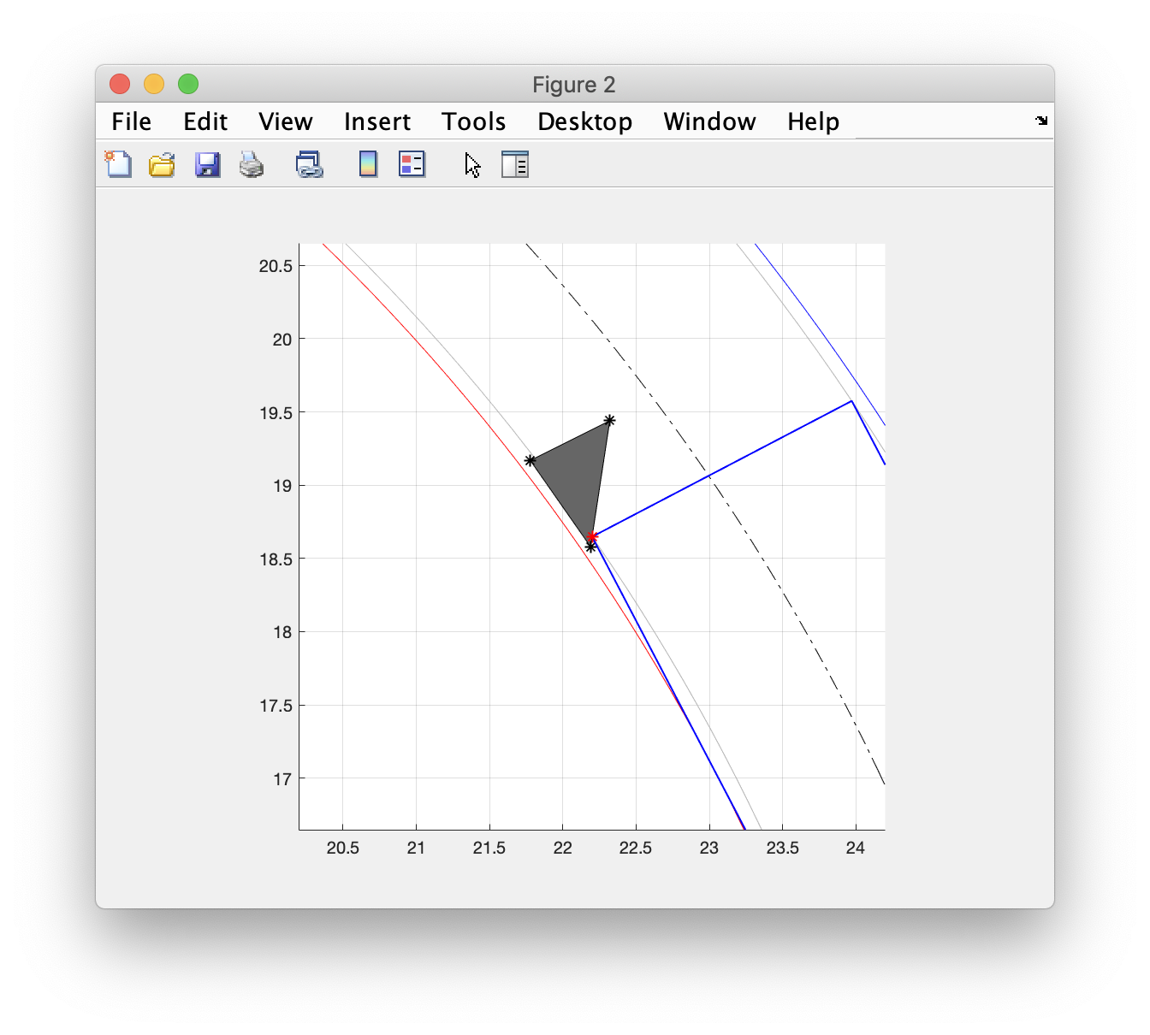
Vertex between inside front corner and min radius

Slide 6
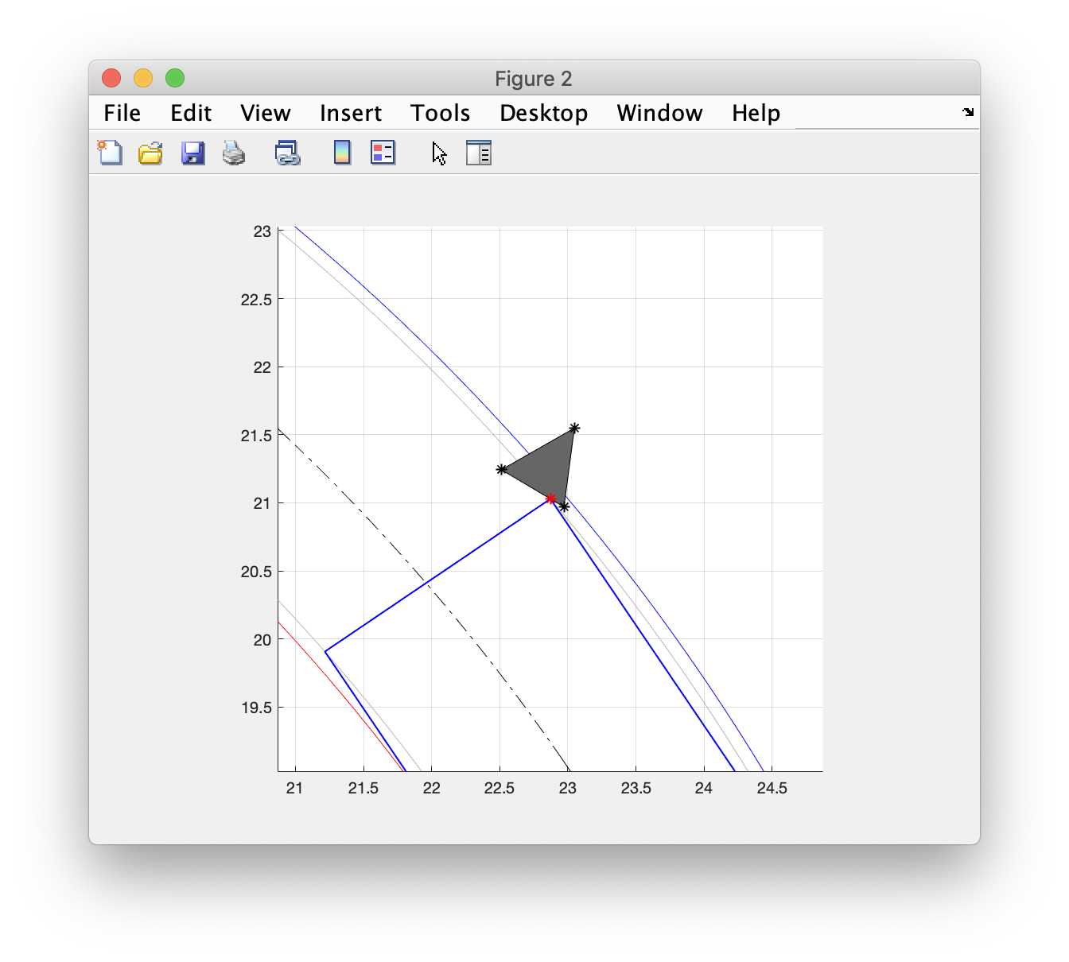
Vertex between outside front corner and max radius

Slide 7
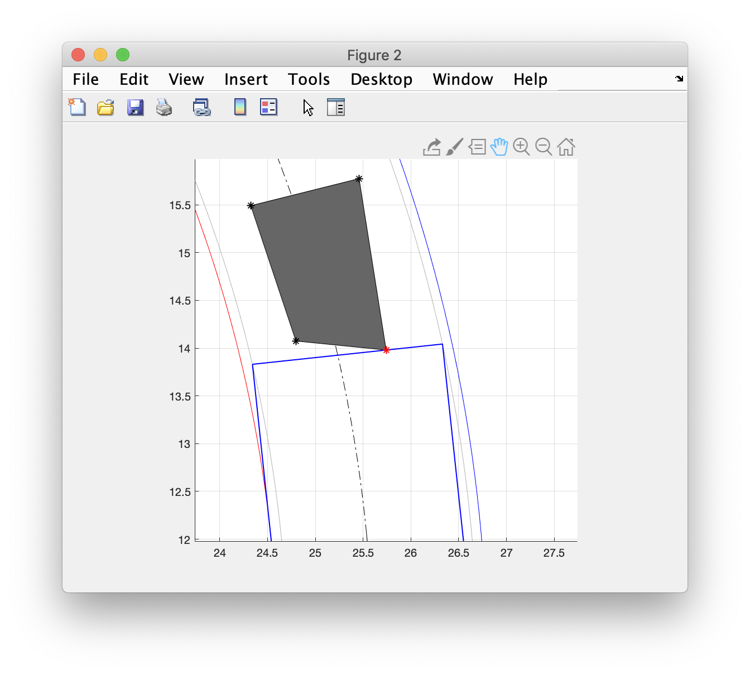
Edge entirely within track width

Slide 8
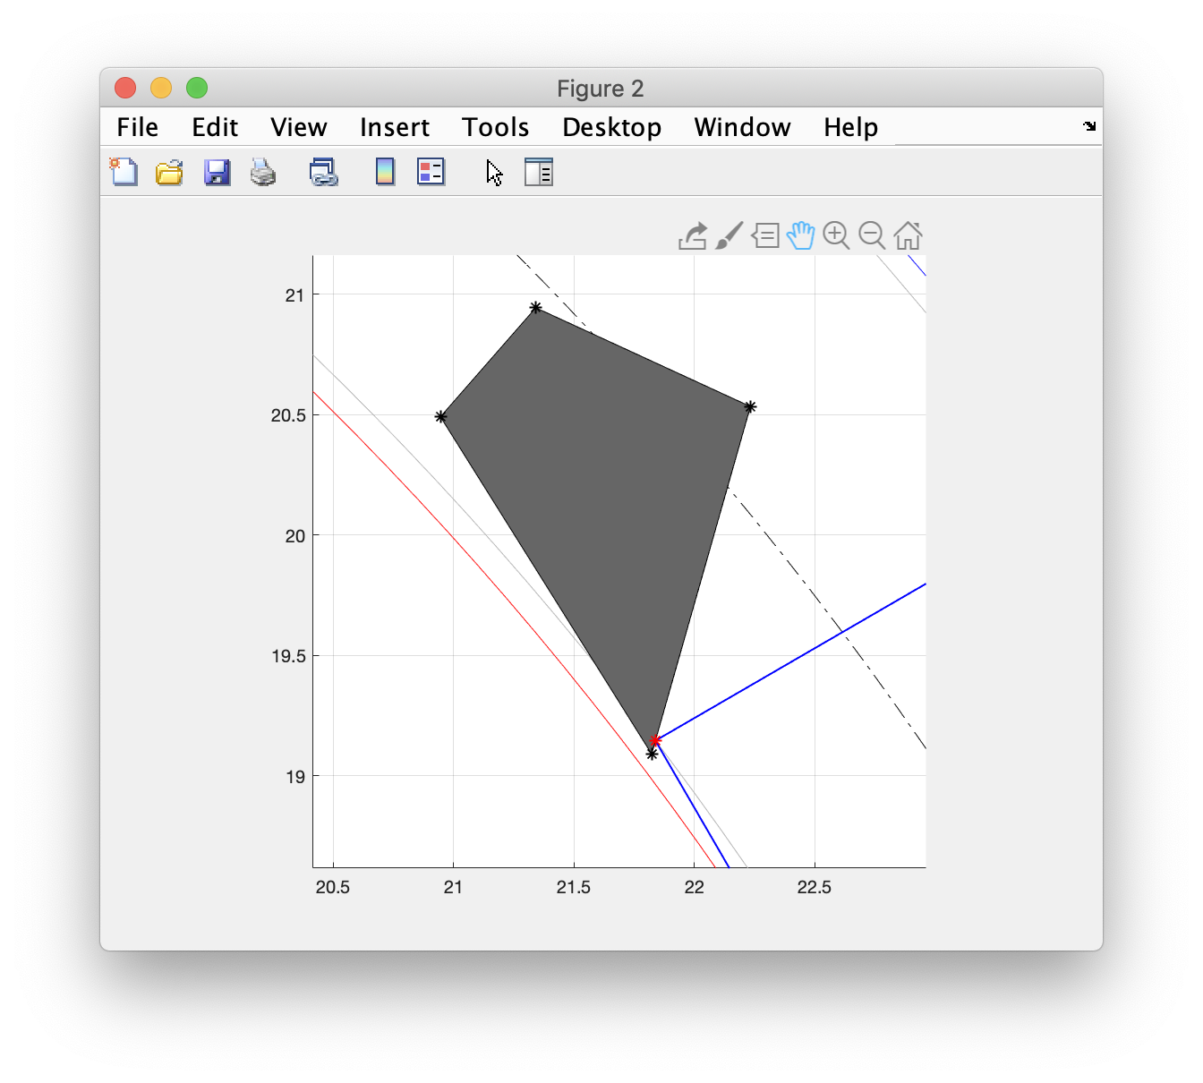
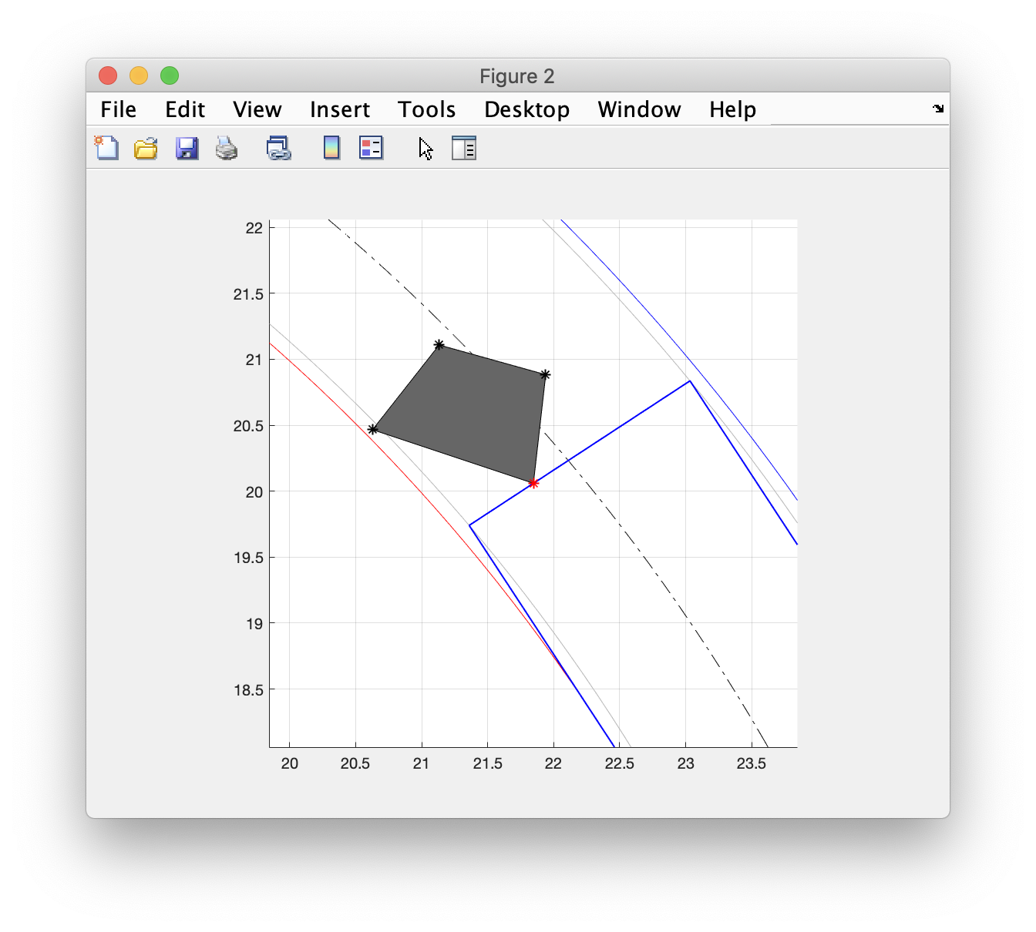
Edge between min radius and track width

Slide 9
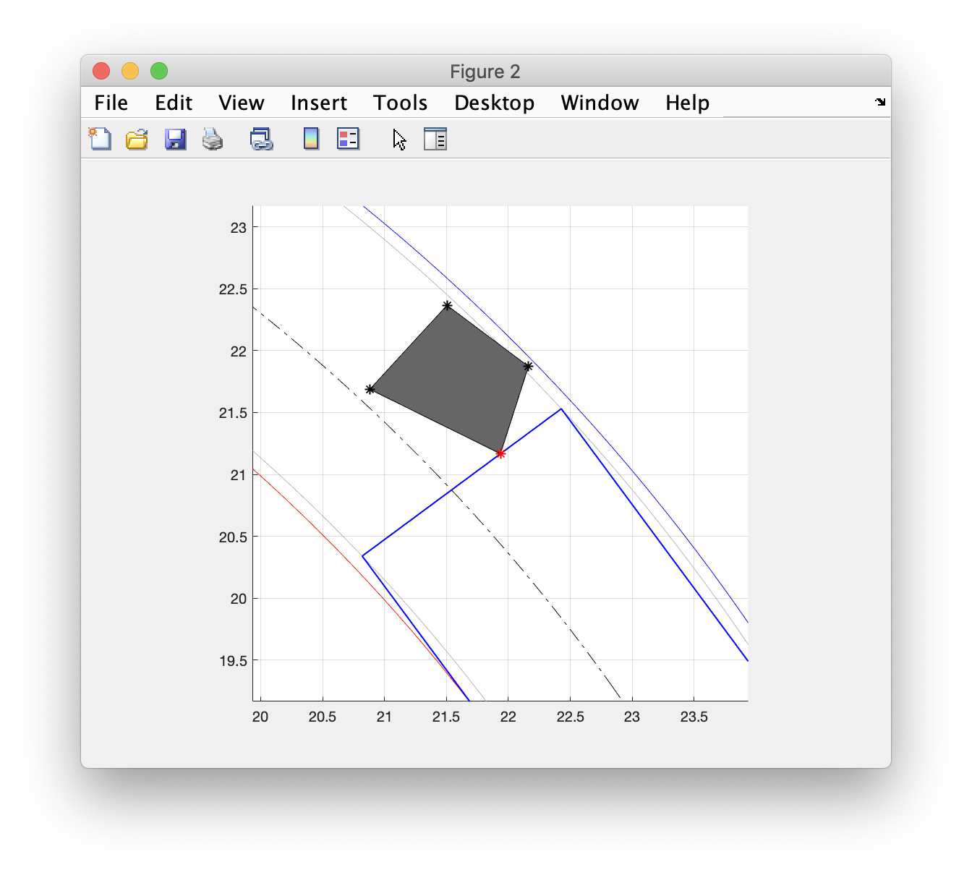
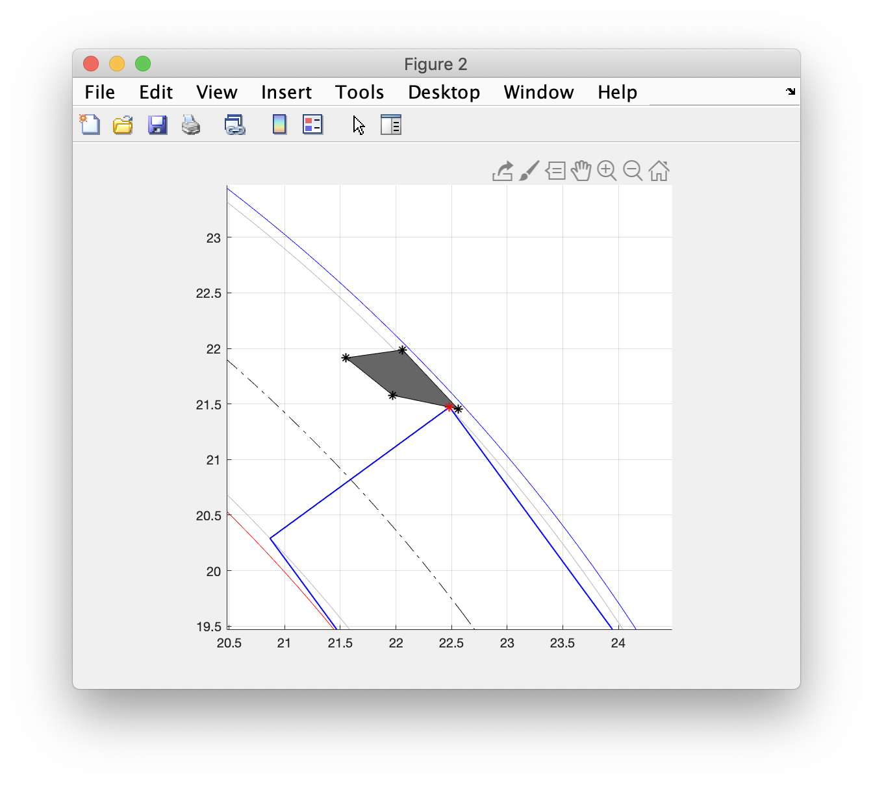
Edge between max radius and track width

Slide 10
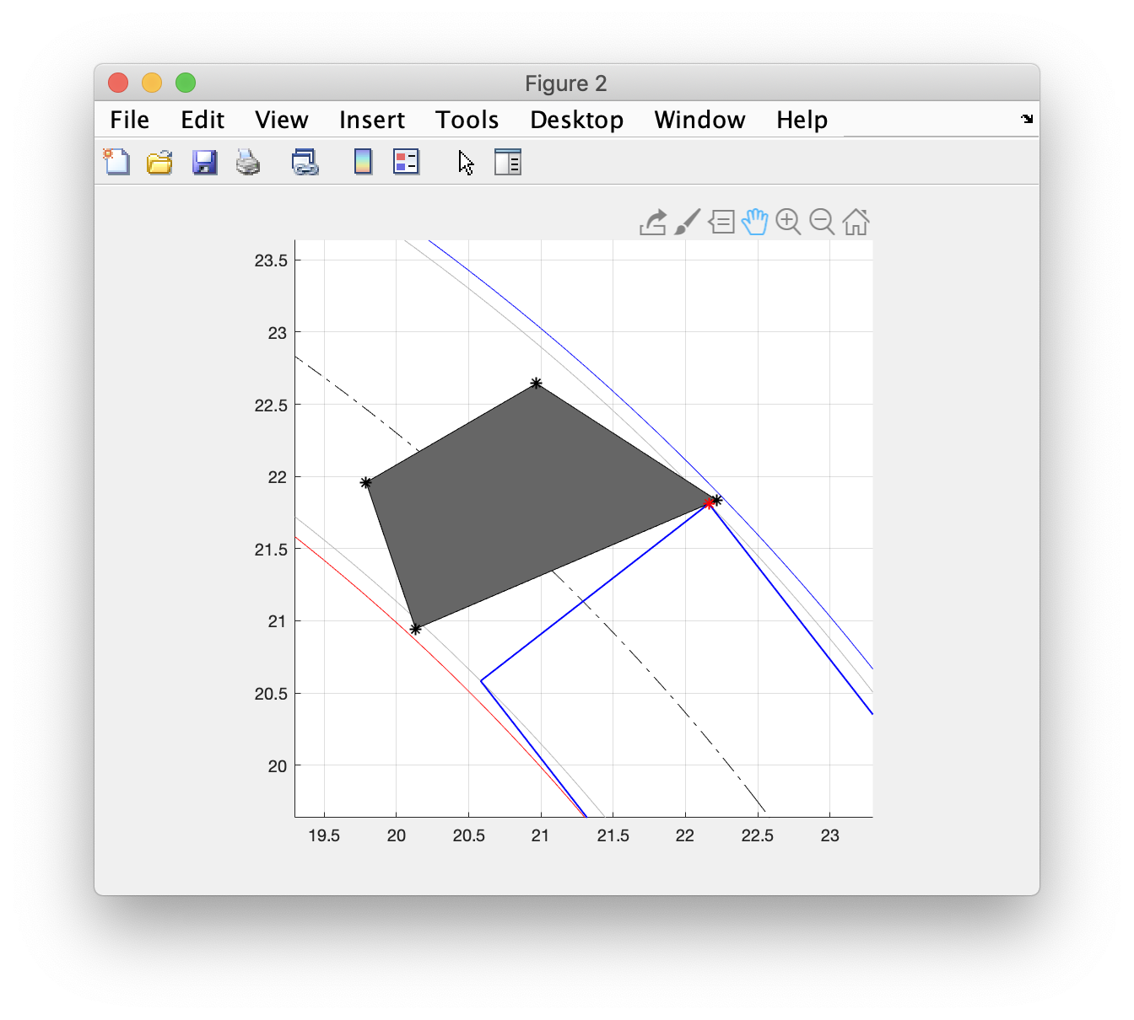
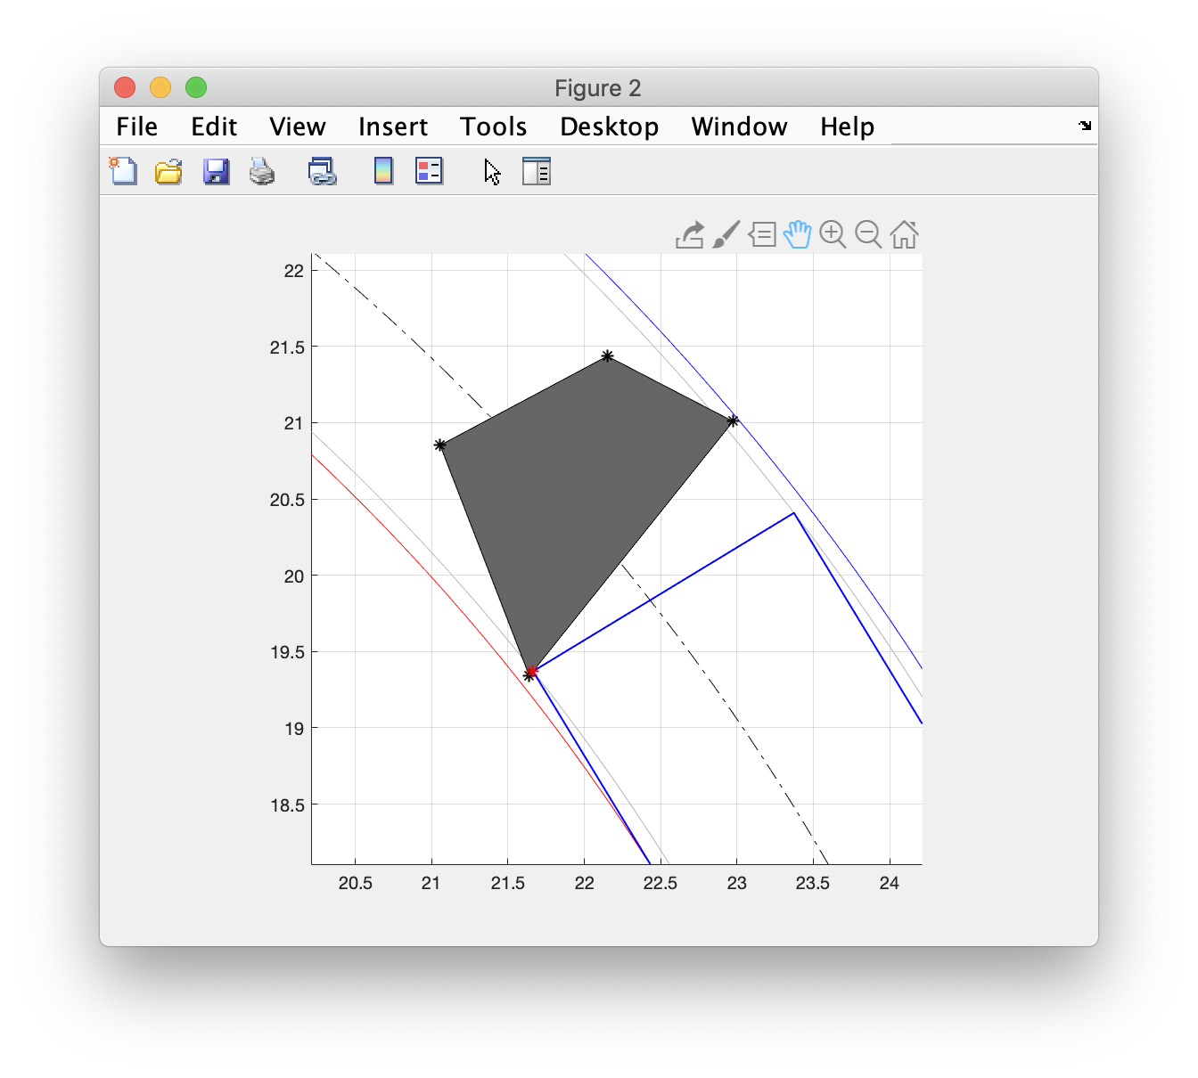
Edge spans the track width but vertices within min and max radii

Slide 11
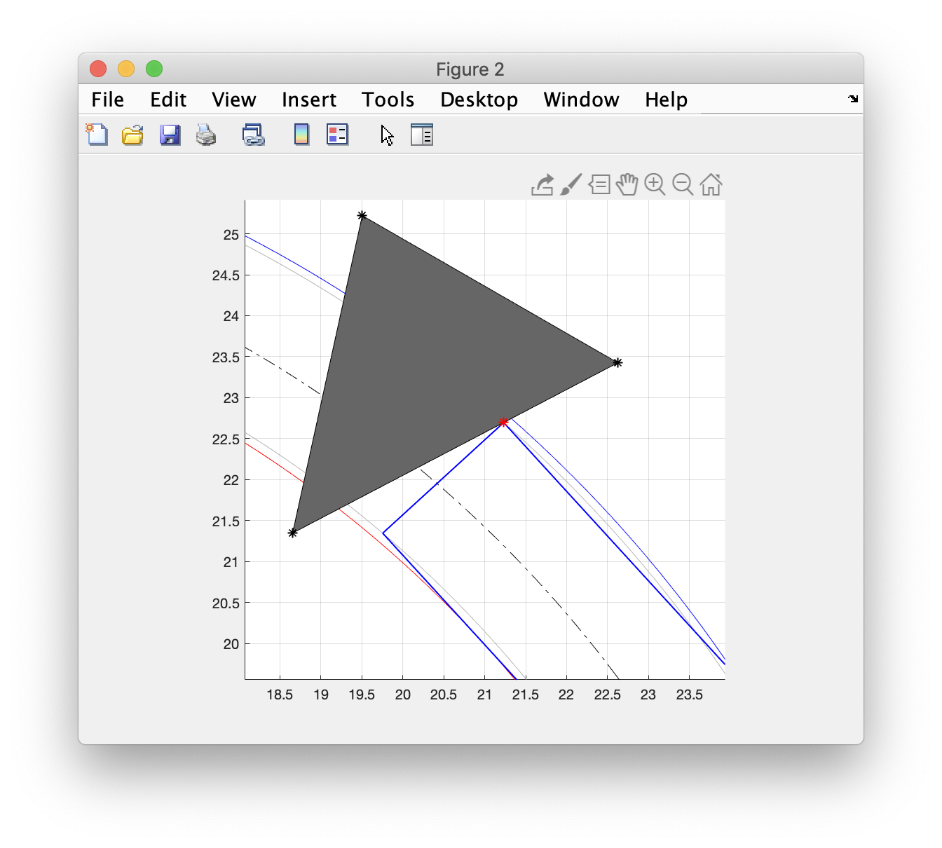
Edge spans min and max radii

Slide 12
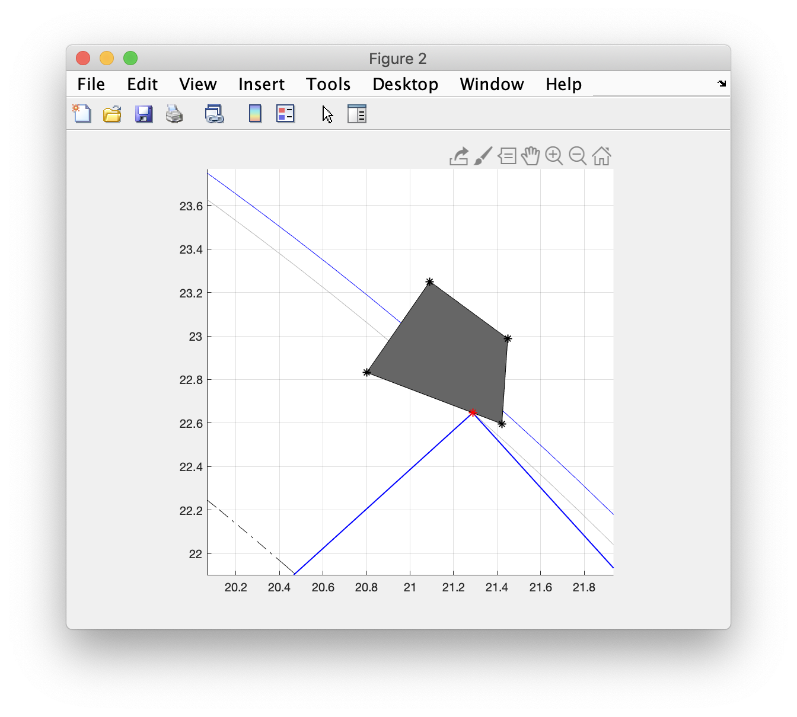
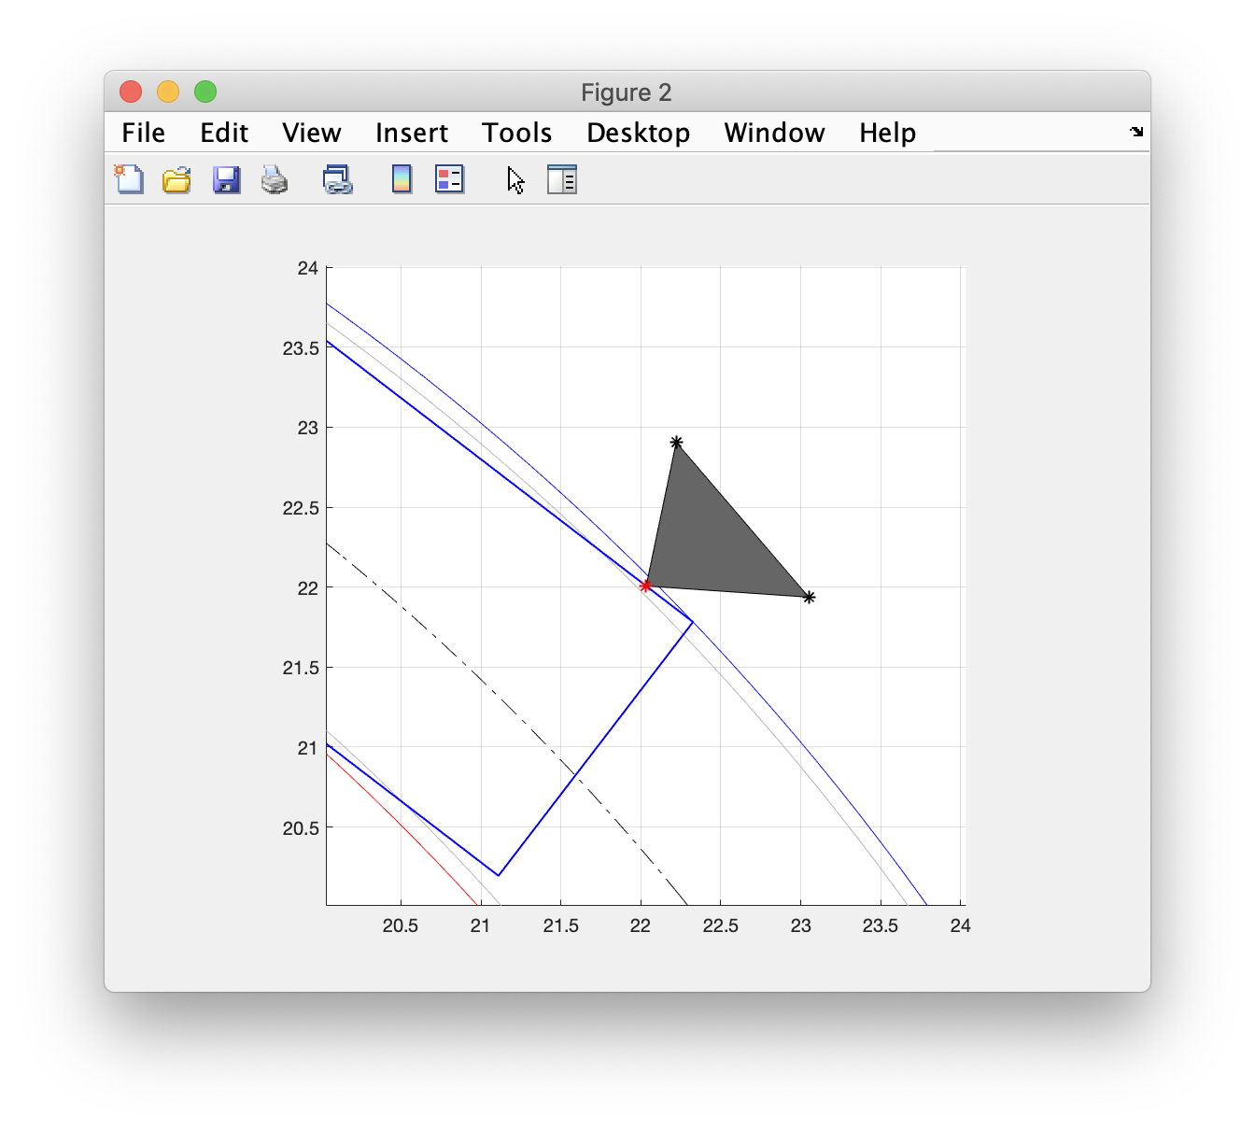
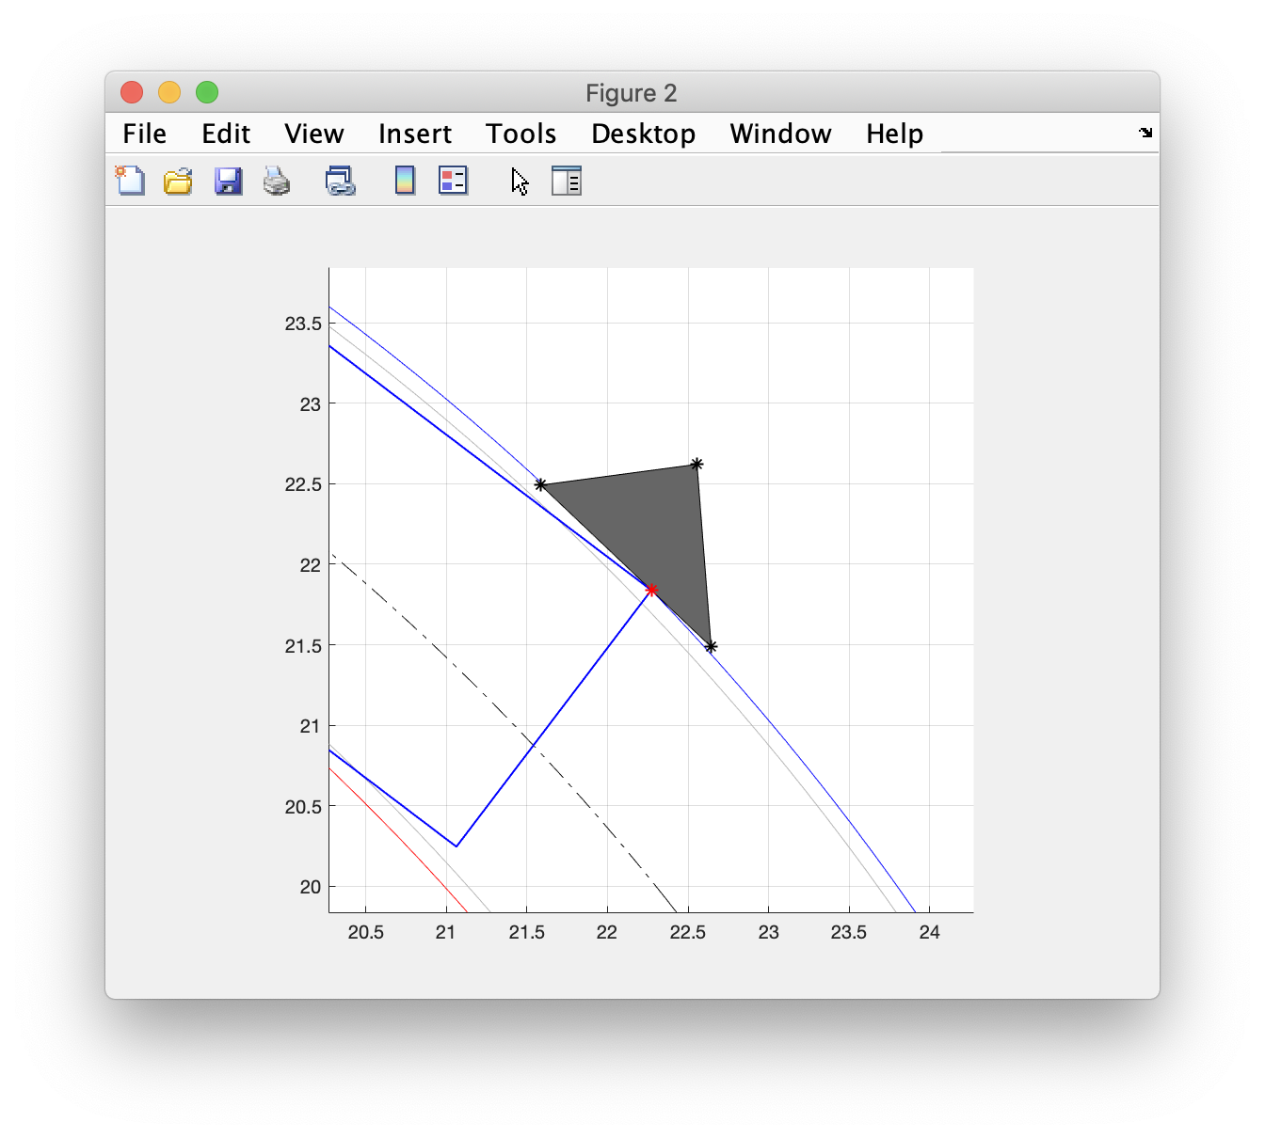
Edge spans max radius with vertex outside of outer front track radius

Slide 13
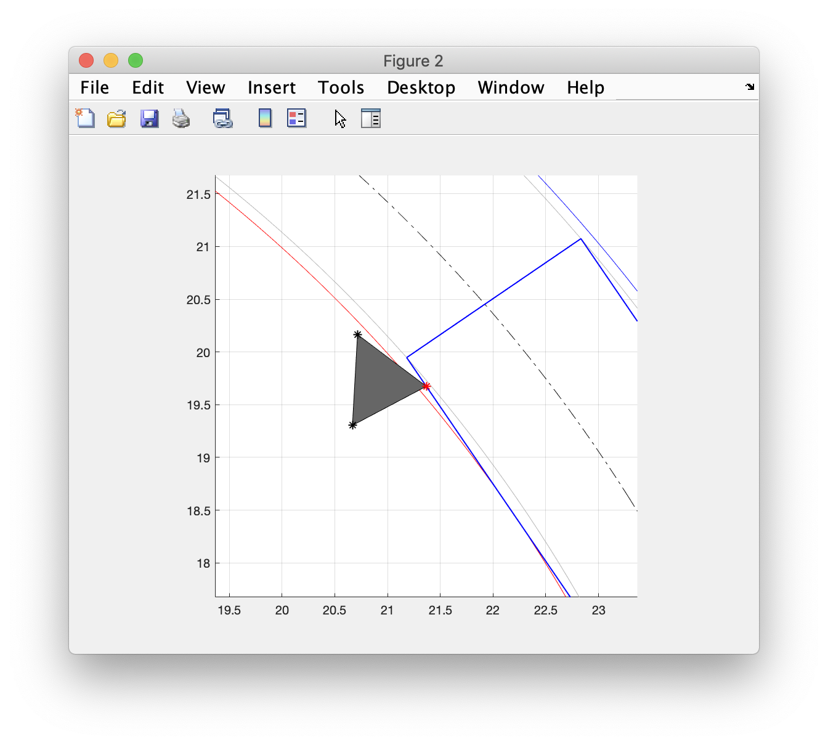
Edge spans min radius with vertex outside of inner front track radius

Slide 14
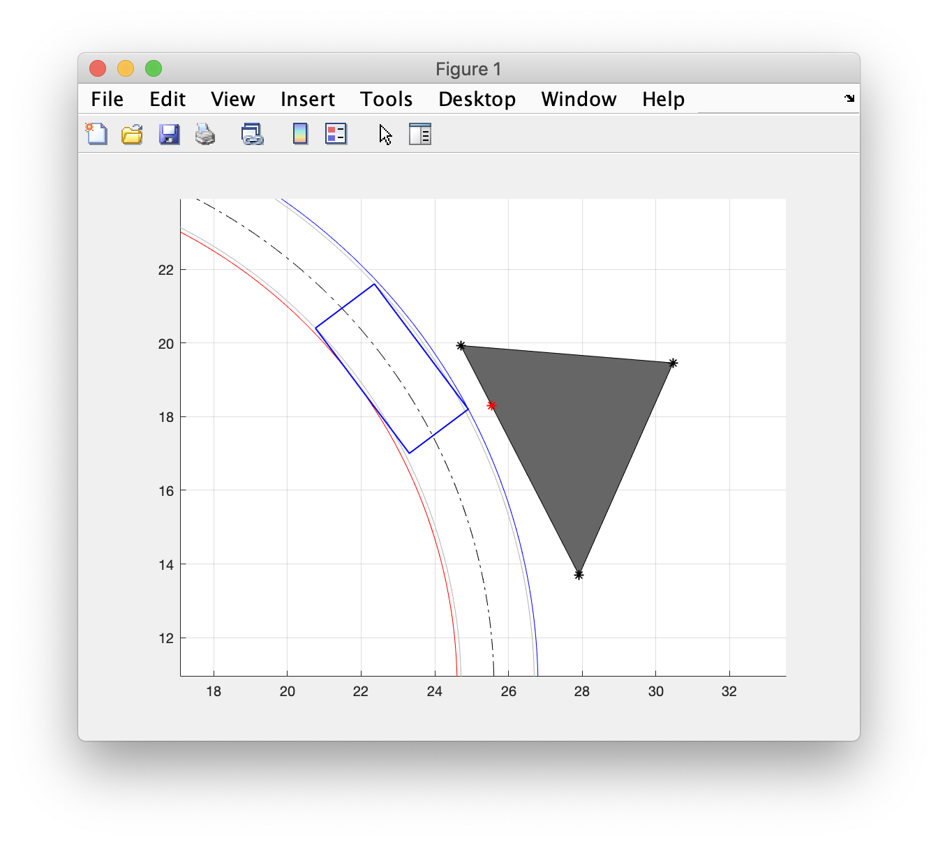
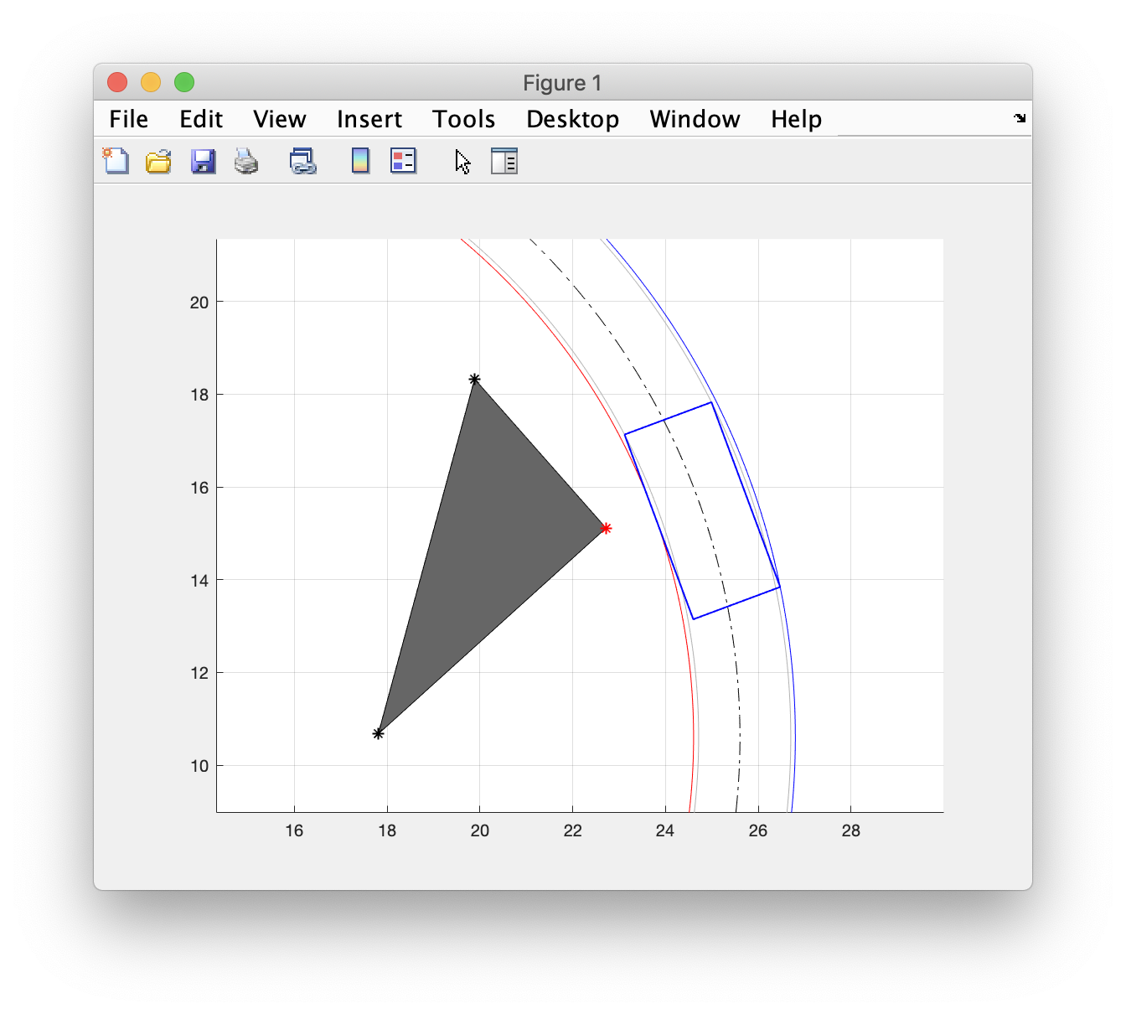
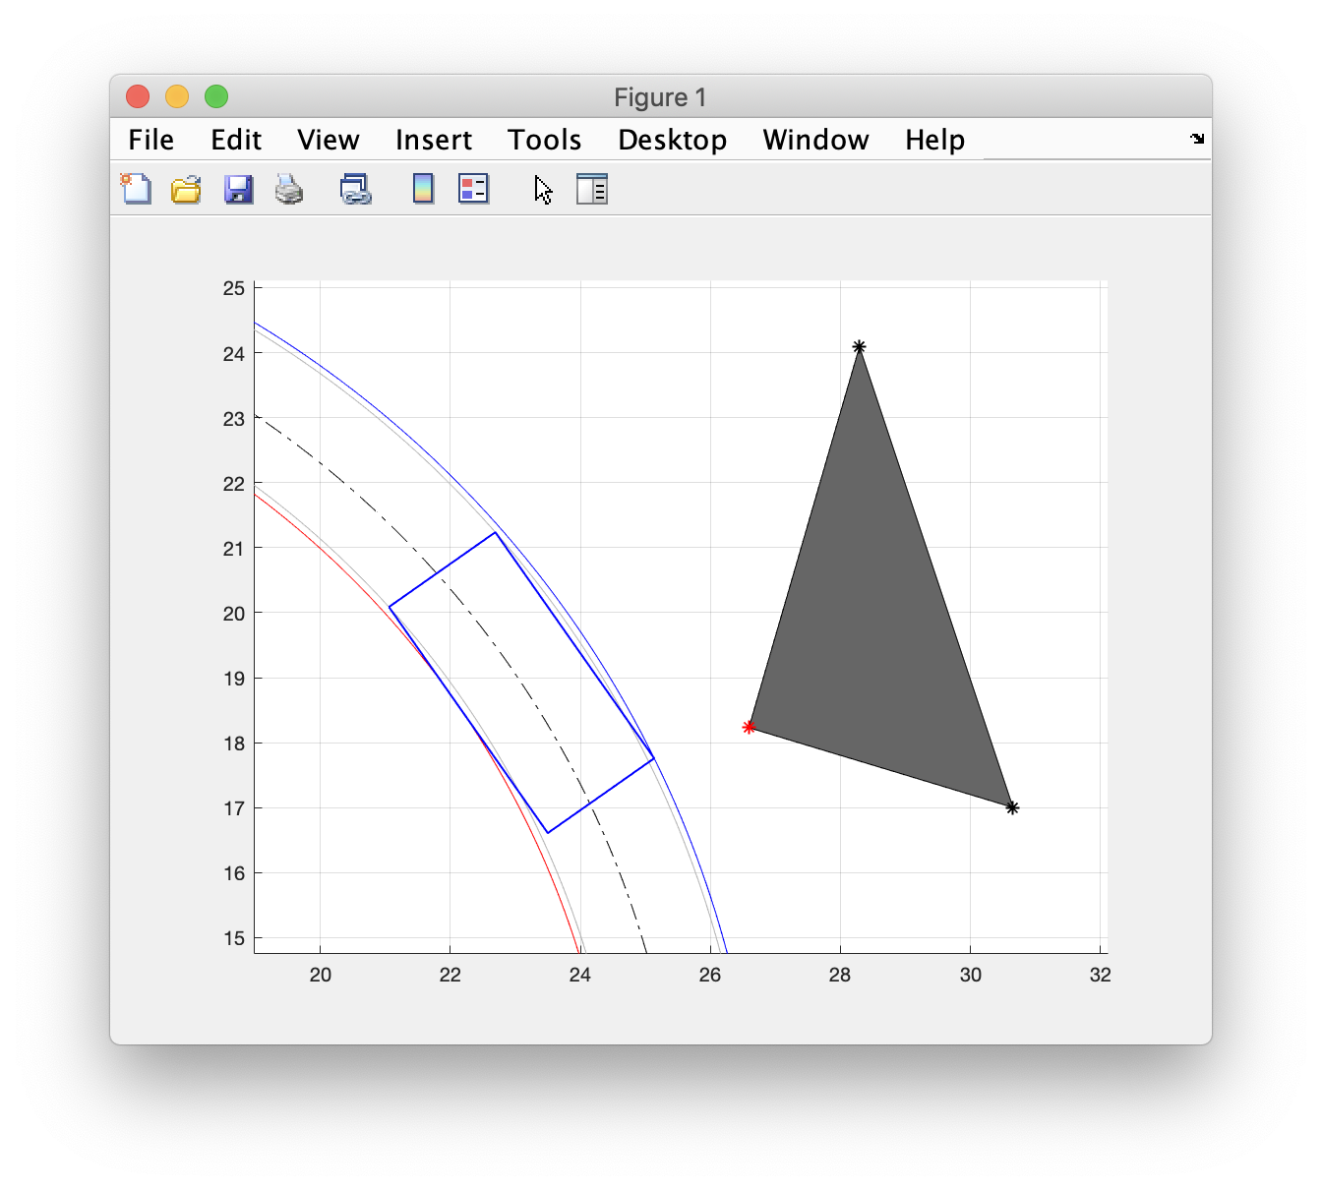
Vertices outside max/min radii (near miss)

Slide 15
Consistency with ASAM OpenDrive
Coordinate systems are compatible
MATLAB code uses X,Y to represent ODR inertial E,N
Obstacles are compatible
MATLAB code uses point cloud for vertices and/or cylindrical/rectangular prism primitives
ODR uses “corner road” and “corner local” for the vertices, with (arbitrarily rotated) rectangular or circular bounding “box” of an object
Vehicle trajectories are compatible
MATLAB code uses circular trajectories to define vehicle travel
ODR uses ”road” “arcs”

